Slide 1
I2C Module
HCM - 12/10/2021

Slide 2
Agenda
Physical interface
Signal / Timing
Frame Structure
SMT32 I2C

Slide 3
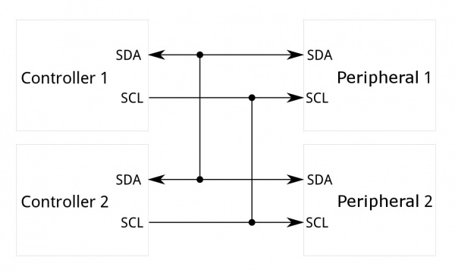
I2C – Physical interface
Multi controller (Master)
No “Chip Select” Pin

Slide 4
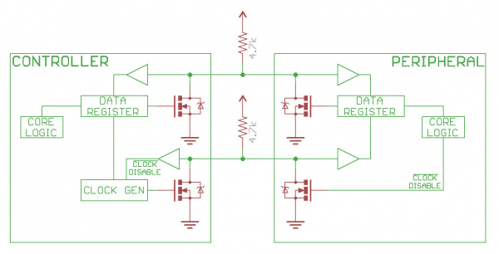
I2C - Circuit

Slide 5
I2C - Features
I2C means Inter-circuit Communication
Allow multiple "peripheral" digital integrated circuits ("chips") to communicate with one or more "controller" chips (multi-master)
Short distance communications within multi master & multi slave
Speed: 100 kHz or 400 kHz

Slide 6
I2C – Signal Description
Each I2C bus consists of two signals: SDA and SCL. SDA (Serial Data) is the data signal and SCL (Serial Clock) is the clock signal.
The clock signal is always generated by the current bus controller
The I2C bus drivers are "open drain", meaning that they can pull the corresponding signal line low, but cannot drive it high (need external pull-up resistor 4.7K or 10K)
There can be no bus contention where one device is trying to drive the line high while another tries to pull it low, eliminating the potential for damage to the drivers or excessive power dissipation in the system

Slide 7
I2C - Frame
Messages are broken up into two types of frame:
  An address frame, where the controller indicates the peripheral to which the message is being sent
  One or more data frames, which are 8-bit data messages passed from controller to peripheral or vice versa
Data is placed on the SDA line after SCL goes low, and is sampled after the SCL line goes high.

Slide 8
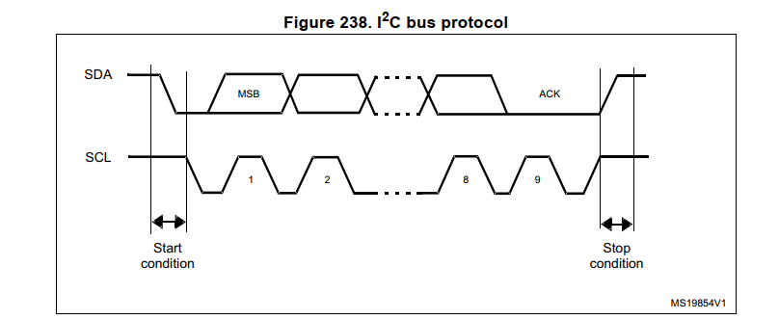
Protocol (1)

Slide 9
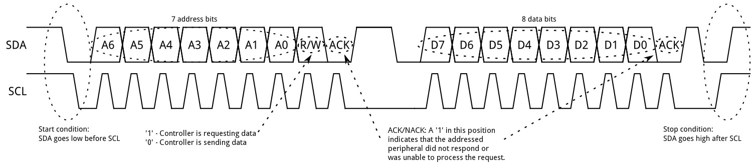
Protocol (2)
Send bit A6
Sample bit A1
Start bit: SCL HIGH – SDA falling edge
Stop bit: SCL HIGH – SDA Raising edge

Slide 10
Start Condition
To initiate the address frame, the controller device leaves SCL high and pulls SDA low
This puts all peripheral devices on notice that a transmission is about to start.

Slide 11
Address Frame
For a 7-bit address, the address is clocked out most significant bit (MSB) first, followed by a R/W bit indicating whether this is a read (1) or write (0) operation.
The 9th bit of the frame is the NACK/ACK bit. This is the case for all frames (data or address) (response from I2C Slave)
Once the first 8 bits of the frame are sent, the receiving device is given control over SDA

Slide 12
Data Frames
The controller will simply continue generating clock pulses at a regular interval, and the data will be placed on SDA by either the controller or the peripheral, depending on whether the R/W bit indicated a read or write operation

Slide 13
Stop condition
Stop conditions are defined by a 0->1 (low to high) transition on SDA after a 0->1 transition on SCL, with SCL remaining high

Slide 14
Applications
System Management Peripheral: Voltage Supervisor, Temperature Supervisor, …
Common sensor: Light, Accelerometer, Heartbeat, …
Inter-processor communication
…..

Slide 15
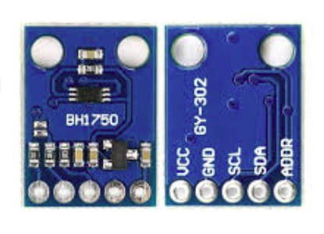
BH1750 sensor
VCC: 3V3
I2C: SCL & SDA
ADDR: Address -> Check sensor datasheet

Slide 16
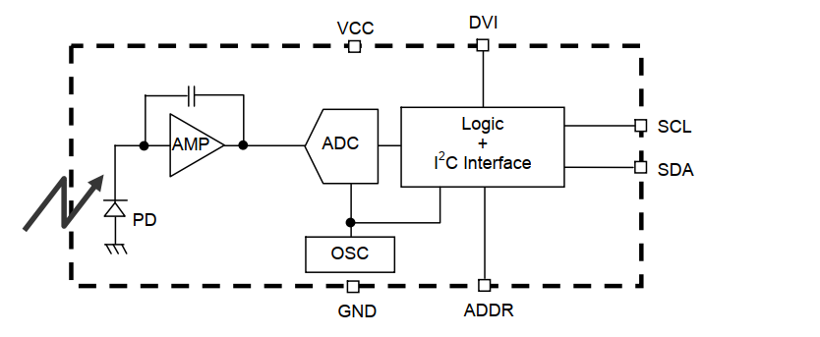
BH1750 Block Diagram
Measure light intensive, unit LUX

Slide 17
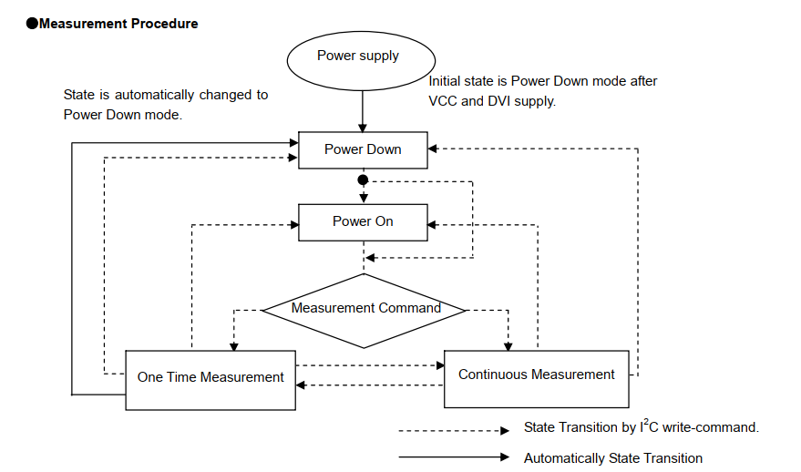
BH1750 State Chart

Slide 18
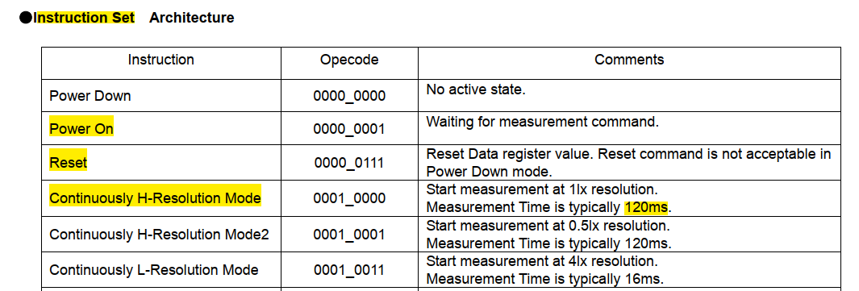
BH1750 - Instruction

Slide 19
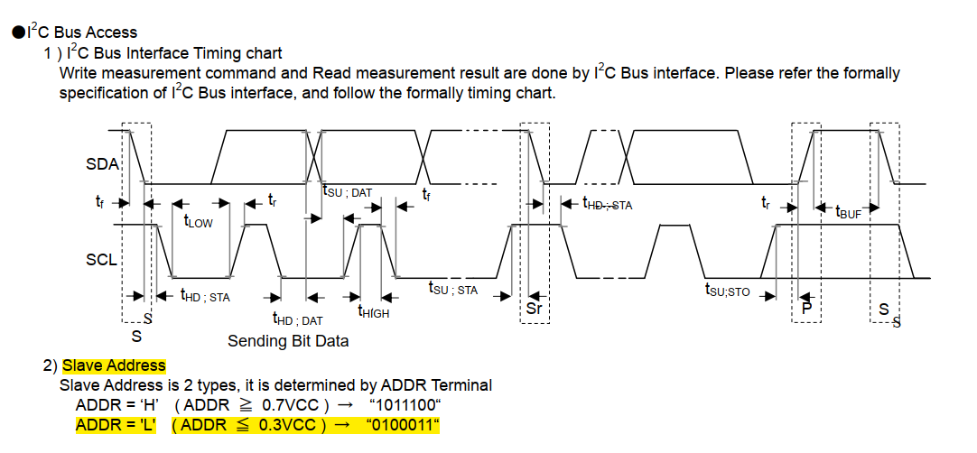
BH1750 – I2C Timing Diagram

Slide 20
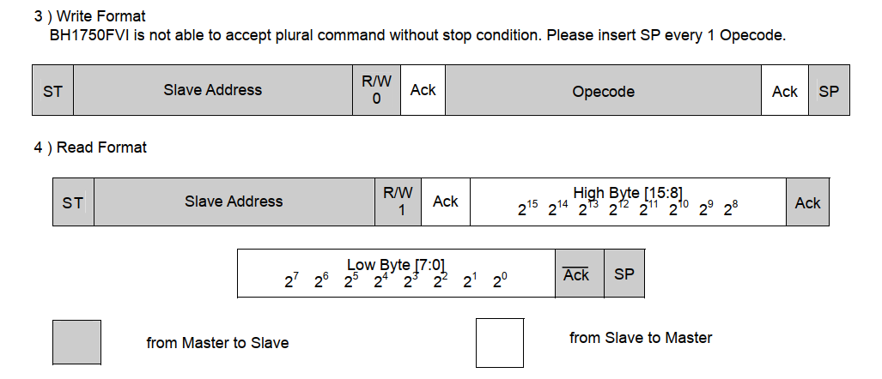
BH1750 – I2C Frame

Slide 21
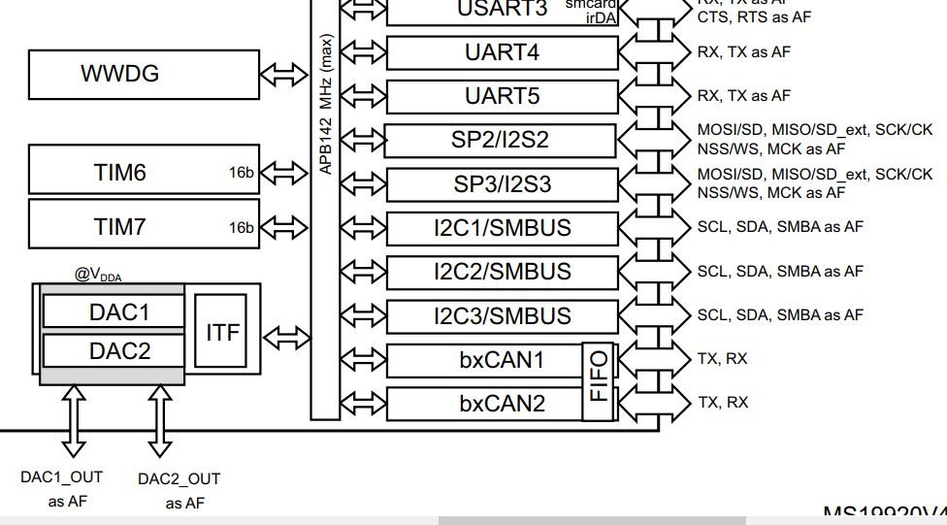
STM32 I2C
SMBUS: extended from I2C – System Management Bus (voltage, temperature, fans, …)

Slide 22
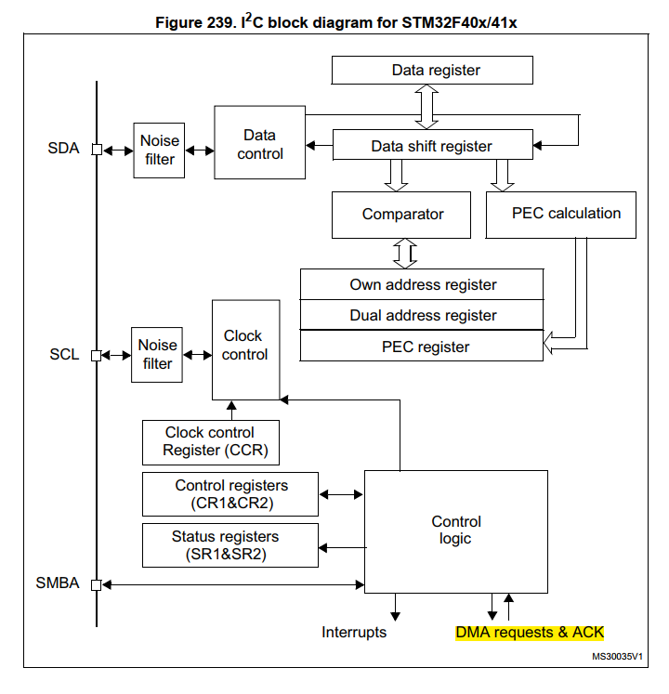
STM32 I2C - Diagram

Slide 23
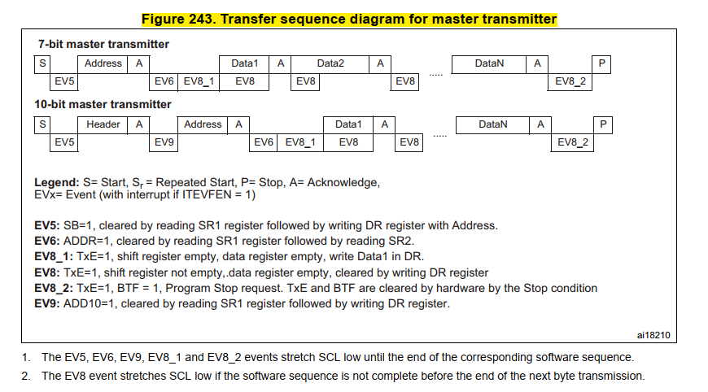
STM32 – I2C Transmitter

Slide 24
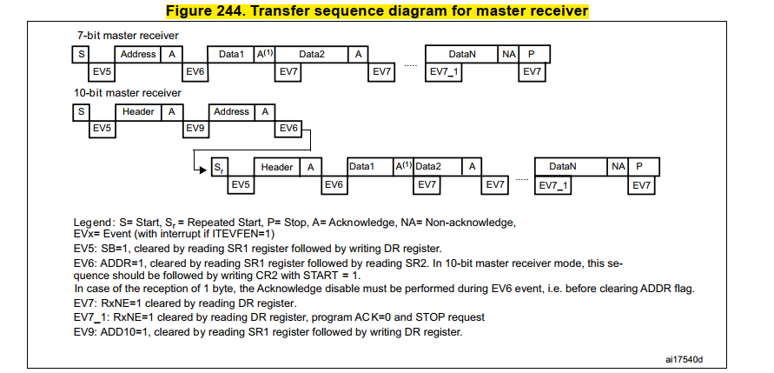
STM32 – I2C Receive

Slide 25
Q&A

